Slide 1



Unit 3.1: Fundamentals of Cybersecurity in 5G Networks
Section 3.1.8: PBL - Cybersecurity Risk Analysis in 5G Smart Cities
Part 3: Risk Communication & Decision Support in NeoCity
NeoCity scenario - Connected Traffic Signal System
Notes:
Welcome to the third and final part of this Project-Based Learning activity. Up to this point, you have been introduced to the NeoCity smart traffic signal scenario, and you have performed a structured cybersecurity risk analysis based on a realistic 5G-enabled deployment.
In the first part, you identified the assets, the threat actors, and the attack surfaces around the connected traffic system, especially the services hosted at the MEC. You analyzed potential risks with a focus on maintaining the availability and safety of the road infrastructure.
In the second part, you validated that at least one of those threats is practically exploitable. You executed a DoS attack against the MEC API from a controlled test environment, monitored indicators of service degradation in Grafana, and confirmed that Suricata was able to detect the malicious activity. You also applied mitigation measures and evaluated their effectiveness by analyzing how much residual risk remained after the defense mechanisms were enabled.
This final section focuses on what happens once you have technical evidence. It is not enough to detect and mitigate attacks. You must also communicate risk and support decision-making for stakeholders who are responsible for public services and citizen safety. In NeoCity, the ultimate goal is to understand whether the system can be deployed in real life safely and responsibly.
You will now summarize the key findings, present the residual risk, define prioritized recommendations, and help city decision makers evaluate if the system is ready for operation or if more work needs to be done before going live.”**

Slide 2
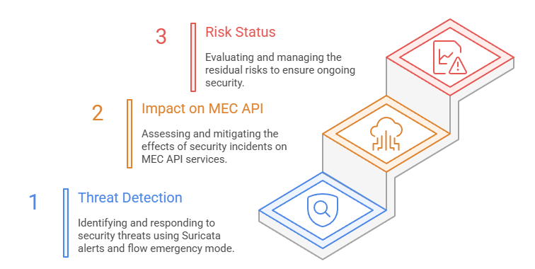

1. Executive Summary of Findings
What did we detect?
Suricata successfully detected flooding attempts against the MEC API
Grafana enabled real-time visualization of abnormal traffic patterns
The MEC API represents a high-impact critical edge service
Risk level increased significantly due to lack of immediate mitigation actions
Residual risk persists until protective measures are deployed and validated
Notes:
In this slide, you take a moment to summarize everything you have achieved so far in the NeoCity scenario. You deployed an IDS at the network edge, executed an attack simulation, and confirmed that the MEC API is vulnerable to traffic floods. The idea is to build a clear picture of why the threat you observed matters for the connected traffic system.
The first finding is related to threat detection. Suricata successfully identified abnormal traffic patterns during the DoS simulation. You saw alerts in the logs and indicators such as flow emergency mode. This proves that the system has visibility over malicious behavior.
The second finding highlights the impact on the MEC API. The MEC API is essential for coordination between connected vehicles and the traffic infrastructure. If this service slows down or becomes unavailable due to an attack, mobility decisions may be delayed or lost. This means not only degraded system performance but also a potential risk to public safety in a real smart-city deployment.
The third finding focuses on risk status. While detection is in place, there are still no automated countermeasures to contain the attack. That gap allows the threat to escalate quickly. The risk level increases because the system heavily depends on the availability of this single MEC service.
Finally, there is residual risk. Even though you can detect the attack and observe the impact, the service can still be disrupted. Without protective measures deployed and validated, NeoCity remains exposed.
This summary serves as the bridge into the next step of the activity. You will now examine how to communicate risk, how to prioritize mitigation actions, and how to support decision-making to better protect the smart-traffic infrastructure.

Slide 3
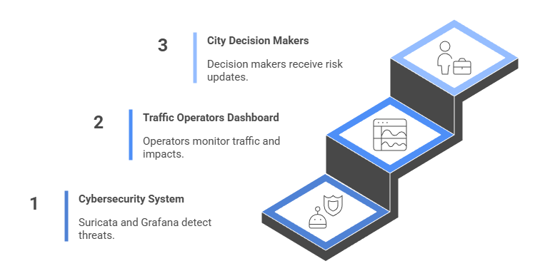
2. Risk Communication in NeoCity
Who needs to know?
Communicate security alerts clearly to decision makers
Prioritize risks affecting safety-critical mobility services
Translate technical indicators into operational impact
Support timely decisions for incident response
Ensure stakeholders understand residual risk and uncertainty
Notes:
In this slide, you focus on how the detected risk is communicated to the people responsible for making operational decisions in NeoCity. Up to now, you have used Suricata and Grafana to uncover a security threat affecting a safety-critical edge service: the MEC API supporting smart mobility. The next step is ensuring that this information reaches the right stakeholders, clearly and quickly enough to enable protection actions.
First, you should be able to communicate security alerts in a way that decision makers can understand. Technical messages about SYN flood attempts or flow emergency mode are not easy to interpret if someone does not work in cybersecurity. Good risk communication translates these signals into clear statements about service impact, such as delays in traffic operations or possible safety concerns.
Second, you must prioritize risks related to safety-critical mobility services. In NeoCity, the MEC platform may support traffic coordination, pedestrian warning, and emergency routing. Any disruption to this service poses a high-impact risk, even if the attack itself is relatively simple.
Then, you need to convert technical indicators into operational impact. Grafana dashboards play an important role here, because they illustrate how traffic changes during abnormal conditions. This enables timely decisions. When the dashboard shows increasing flow queue or more severe performance degradation, operators can trigger mitigation workflows earlier.
Finally, residual risk must be explained. Even after detection, protection and validation are pending. Stakeholders must know that the system is still vulnerable until countermeasures are deployed and tested.
Overall, this communication ensures that the right message reaches the right people at the right time. It creates a bridge between cybersecurity monitoring and smart-city operational safety, allowing NeoCity to decide effectively how to react to the detected threat.

Slide 4
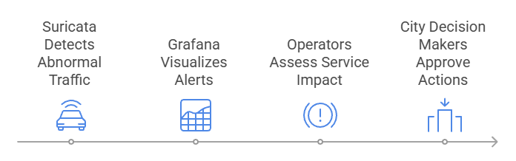
3. Residual Risk Monitoring & Decision Triggers
When must action be taken?
Continuously track residual risk after alerts are raised
Identify thresholds that require immediate operator action
Evaluate service degradation indicators (latency, error rate, request drops)
Recognize when abnormal traffic threatens public safety services
Escalate decisions when risk exceeds tolerance for NeoCity mobility
Notes:
In this slide, you explore how residual risk is monitored after a cybersecurity alert has already been detected and communicated. Suricata and Grafana give you visibility of abnormal traffic, but until the threat is mitigated, a level of risk persists that can still impact the mobility and safety services in NeoCity. That is why the monitoring phase is essential for supporting continuous operational awareness.
You track how risk evolves over time. Even if the initial alert does not cause a service failure, traffic patterns may intensify and lead to performance degradation. Here, you focus on metrics that translate technical anomalies into operational impact. Examples include request timeouts, slowdown in API response times, or a decline in traffic signal update success rate. These are all direct indicators that a threat is transitioning from a technical event into a safety-critical issue.
Residual risk monitoring enables decision triggers. You define thresholds that determine when action is required. Below the first threshold, the risk remains acceptable. When the system crosses into the warning zone, operators should prepare mitigation actions. If the risk enters a critical range, it becomes necessary to escalate and involve decision authorities that have the mandate to modify service behavior, such as enforcing traffic control policies or applying network protections.
You also want to ensure timely decisions that reflect the urgency. In a connected traffic scenario, delays in responding to increasing risk can result in accidents, congestion, and loss of trust in smart city infrastructure.
So the goal of this slide is to show that risk does not stop evolving after the alert. You need to monitor it, understand what triggers action, and who has the authority to approve each decision.

Slide 5
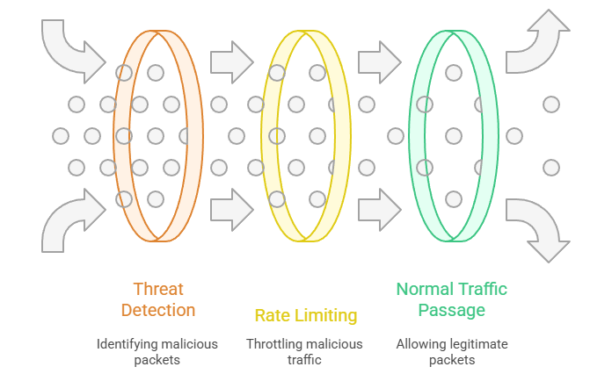
4. Mitigation Strategy A: Rate Limiting (Network vs API Layer)
Rate-Limiting Approaches for Protecting the MEC API
Control excessive traffic to maintain service availability
Apply mitigation close to the point of overload (Edge)
Reduce the impact of DoS attacks on the MEC API
Choose an enforcement layer based on performance and visibility needs
 | Network-Level Rate Limiting | API Gateway Rate Limiting
Scope | TCP/UDP connections and flows | API requests (HTTP/MQTT)
Strength | Stops volumetric SYN floods early | Protects service logic and sessions
Control | Less context about purpose | Full visibility into API usage
Overhead | Low processing cost | Higher CPU/latency overhead
Best for | High-rate DoS traffic | Credential abuse or misuse patterns
Notes:
In this slide, you learn how rate limiting can be used to protect the MEC API from the kind of flooding attacks that you observed in NeoCity. The idea is simple: when abnormal traffic volumes are detected, you want to control excessive traffic before it overwhelms the edge service. Rate limiting acts as a buffer that prevents malicious or unintended load from consuming all available resources.
There are two layers where rate limiting can be applied, and each brings different benefits in terms of performance and visibility.
On the left, we have Network-level rate limiting. This is typically implemented on routers, firewalls, or edge infrastructure. It works at the TCP or UDP flow level, meaning it focuses on connections rather than application logic. Because it operates earlier in the path, it can stop high-rate DoS traffic very efficiently, especially low-cost attacks like SYN floods. It has a low processing overhead, so it scales well. However, it lacks context: the network layer does not know whether a flow is legitimate or part of an API misuse scenario.
On the right, you see API Gateway rate limiting. This operates at the application layer, so it understands API requests, user identities, tokens, and sessions. That provides fine-grained control, making it great for stopping credential abuse, repeated unauthorized access attempts, or bot-based API misuse. The trade-off is higher processing cost and potential added latency, because every request must be inspected.
The key message for you is that rate limiting should be applied close to the point of overload, and the selection depends on what threat you want to mitigate. If the traffic volume is enormous, go network-level. If the attack targets business logic, go API-level. In many real deployments, both are used together, forming a layered defense that improves service continuity and reduces residual risk for the connected mobility services in NeoCity.

Slide 6
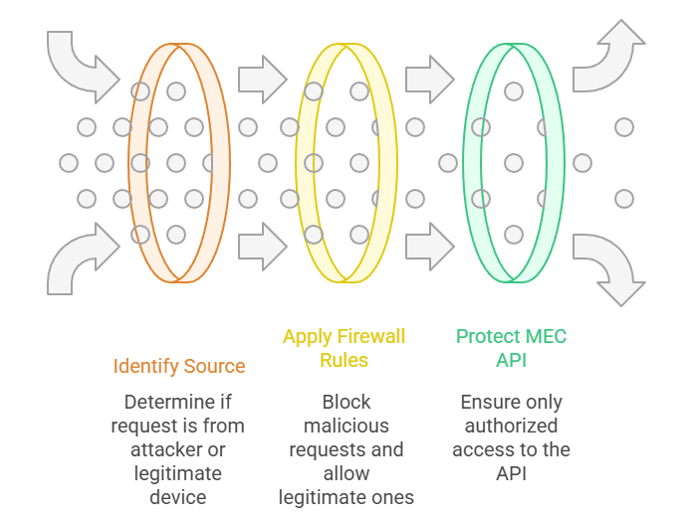
5. Mitigation Strategy B: Source Blocking
Prevent known attacker reachability
Block malicious IP/ports/subnets detected by Suricata
Reduce repeated DoS traffic from identified attackers
Quick containment while deeper defense is prepared
Best used when the attacker’s identity is consistent and traceable
Often implemented at firewalls, SDN switches, or edge routers
Notes:
Now, we focus on source-based blocking as a practical mitigation strategy in NeoCity. Once Suricata identifies suspicious or malicious behavior, for example, a pattern of repeated flooding attempts, the next step is to decide what we enforce against the origin of that traffic.
Source blocking means we apply filtering rules at the network perimeter or edge components, such as the MEC-hosting firewall or SDN switch. You monitor where the malicious packets are coming from and block that communication path, so the attacker cannot continue stressing the MEC API infrastructure.
This mitigation option is fast to deploy because it relies on simple and robust rules: deny an IP, a subnet, or a set of known malicious ports. So if the threat is persistent and originates from a small number of visible sources, blocking is a very effective way to reduce impact immediately.
The visual on the slide illustrates the logic. First, identify the Source: differentiate between legitimate traffic and traffic coming from the attacker. Second, Apply Firewall Rules: enforce edge-level filtering that drops malicious requests while continuing to allow legitimate ones. Finally, Protect MEC API: ensure that only authorized and safe requests reach the critical service.
This approach is a great containment measure, but it comes with caution. Attackers can spoof or rotate IP addresses. So while source blocking works well against static threats or poorly equipped adversaries, it may not be enough against sophisticated attackers who frequently change identity or come from large botnets.
What source blocking offers is an operational win: we buy ourselves time, reduce the immediate damage, and allow the system to keep functioning while broader protective measures are deployed. In a real NeoCity context, traffic operators want something fast, simple, and reliable, and this option checks those boxes.

Slide 7
6. Mitigation Strategy C: Suricata Active Drop Rules
Inline detection-driven mitigation
Enable Suricata to both detect and block malicious traffic
Automate response based on rule matches and severity
Reduce attack impact without human intervention
Maintain protection close to the service under attack
Useful when the attacker’s identity is dynamic or spoofed
Aspect | Pros | Cons
Scope | Targets only traffic confirmed as malicious | Dependent on rule quality and coverage
Effectiveness | Stops attacks immediately upon detection | Evasion possible with new/unknown attack patterns
Automation | No manual operator action required | Risk of false positives impacting legitimate users
Performance | Applied close to the MEC service → reduced stress | Some CPU/memory overhead under high traffic
Best Use Case | Smart detection-driven protection | Requires active tuning and monitoring
Notes:
This mitigation focuses on taking Suricata beyond its role as a monitoring and alerting tool. Instead of simply detecting malicious traffic and notifying operators, we can configure Suricata to actively drop attack traffic in-line. That means packets are blocked the moment they match a rule, preventing them from ever reaching the MEC API.
The main advantage here is single-tool automation. Suricata already sees the traffic and identifies anomalies; it now becomes the enforcement point too. That eliminates the delay between detection and reaction, which is crucial in a fast-moving attack scenario.
This approach also helps when source identities change, such as in botnet-based floods. Since dropping is triggered by behavior rather than origin, attackers cannot bypass protection simply by changing IP addresses.
However, there are important considerations. Suricata’s detection accuracy determines performance: a poorly-written rule can drop legitimate traffic and disrupt services. And during very high-rate attacks, rule matching adds computational load, which could stress edge nodes if not properly tuned.
The takeaway for NeoCity is that Suricata drop rules provide excellent precision and near-instant reaction, making them a strong option, especially if the threat evolves or remains unpredictable. Operators must ensure that rules are continuously updated and validated to avoid unintended service degradation.

Slide 8
7. Mitigation Strategy D: Operational App Freeze
Service continuity prioritization
Maintain core safety services even under attack
Temporarily disable or throttle non-critical features
Reduce system load to preserve essential mobility functions
Operators or automated triggers decide when to freeze/unfreeze
Ensures fail-safe behavior for connected traffic operations
Aspect | Pros | Cons
Scope | Keeps essential services operational | Reduced functionality impacts user experience
Effectiveness | Eliminates overload by limiting request types | Doesn’t stop attack traffic itself, only limits service exposure
Control | Clear operational decisions and policies | Requires predefined service priorities
Performance | Prevents MEC API crash during peak stress | Might be exploited by attackers to force freeze state
Best Use Case | Critical safety-relevant applications | Short-term mitigation, not permanent solution
Notes:
Operational App Freeze means that instead of trying to block the incoming attack traffic, we temporarily limit what the MEC API is allowed to serve. This mitigation works by prioritizing critical capabilities and pausing anything optional or resource-intensive.
This approach is often used in safety-critical environments such as NeoCity’s traffic mobility services. For example, while under attack, the system could continue providing traffic signal coordination and congestion safety alerts, while temporarily suspending data-heavy features like analytics or non-urgent control services.
The benefits are focused on resilience: the service doesn’t crash, and essential operations continue even if the API is being hammered. It also gives engineers time to analyze the threat and adjust protections without losing availability where it matters most.
However, it is not a primary protection method in itself. Attack traffic still arrives, it’s just that the system decides to do less to stay alive. This also means attackers may intentionally push the system into freeze mode to degrade user service quality.
So, the message for NeoCity: operational freeze acts as a short-term safety net. It doesn’t solve the cyber threat but prevents cascading failures that could disrupt smart city mobility infrastructure. It works best when combined with detection and enforcement methods like those we saw in previous slides.

Slide 9
8. Decision Support Matrix
Prioritizing protection for NeoCity’s smart mobility
Evaluate mitigation options using operational impact criteria
Score based on effectiveness, performance, safety impact, and effort
Combine visual ranking and weighted score for transparent justification
Support evidence-based decision-making for NeoCity authorities
Legend: 🟢 Good | 🟡 Moderate | 🔴 Limited
Mitigation Option | Detection Effectiveness | Service Continuity | Deployment Complexity | Suitability for MEC
A - API Rate-Limiting | 🟡 Medium | 🟢 High | 🟡 Medium | 🟢 High
B - Source Blocking | 🟢 High | 🟡 Medium | 🔴 High | 🟡 Medium
C - Suricata Drop Rules | 🟢 High | 🟡 Medium | 🟡 Medium | 🟢 High
D - Operational Freeze | 🔴 Low | 🟢 High | 🟢 Low | 🟡 Medium
Criterion | Weight | A (API Limit) | B (Source Block) | C (Suricata Drop) | D (Freeze)
Threat detection / enforcement | 40% | 3 | 4 | 4 | 1
Continuity of service | 35% | 4 | 3 | 3 | 4
Deployment feasibility | 25% | 3 | 2 | 3 | 4
Total Weighted Score | — | 3.45 | 3.15 | 3.55 | 2.95
Leading candidate: Mitigation Option C — Suricata Active Drop Rules
(with Option A as a strong complement)
Notes:
On this slide, you can see a structured comparison of all four mitigation strategies we studied. The idea is to support a decision that is not subjective but grounded in clear operational needs of NeoCity.
We evaluated each option using four criteria:
Threat Handling Capability: How well does the method stop malicious traffic?
Service Continuity: Does the city mobility service remain available?
Deployment Feasibility: Can we implement it quickly with the assets already deployed?
Fit for MEC Edge Context: Does it work effectively close to users?
Each criterion has a different weight based on the priority in public-safety mobility systems:
Handling the attack and staying online are top priorities
Deployment requirements and complexity matter, but slightly less
When applying both qualitative and weighted scoring models:
Option C (Suricata Drop Rules) ranks highest
because it delivers strong protective action without stopping legitimate traffic and leverages the existing Suricata deployment.
Option A (API Rate-Limiting) is not far behind and would be a good complement, especially for flood resilience.
Options B and D help in specific cases but are either too disruptive or too complex for first deployment.
This prepares us for the final decision on our mitigation plan.

Slide 10
9. Final Mitigation Decision
Why this approach?
Primary mitigation: Suricata Active Drop Rules (inline enforcement)
Secondary safeguard: API Rate-Limiting (service continuity under load)
Addresses both malicious floods and abuse of API calls
Leverages existing NeoCity infrastructure for rapid deployment
Ensures mobility services remain safe and operational
Defense Layer | Goal | Strength
Suricata Drop Rules | Block attacker packets fast at the edge | Strong enforcement with low delay
API Rate-Limiting | Maintain service quality during overload | Protects MEC logic & sessions
Notes:
Now that we have compared the options, we can justify a final mitigation decision for the NeoCity scenario.
The recommended defense follows a layered security approach, which is a standard in critical infrastructures:
1. Suricata Active Drop Rules
Suricata is already deployed and detecting the threat.
By enabling drop rules, you go from purely monitoring to active mitigation.
Suspicious packets are discarded before they overload the MEC API.
This keeps malicious floods from consuming resources and degrading service quality.
2. API Rate-Limiting
This acts as a backup control when request volume spikes.
If abnormal traffic still reaches the MEC service, the gateway responds by prioritizing legitimate users.
This allows emergency vehicles and mobility automation to continue operating safely.
Together, these two measures give you both speed and resilience:
Suricata handles the attack directly at the network edge
API rate-limiting protects the application logic and preserves availability
NeoCity benefits immediately because:
✓ No additional hardware required
✓ Fast to deploy with existing security stack
✓ Minimal disruption to legitimate users
✓ Supports ongoing risk monitoring and alerts
This concludes the risk mitigation phase and transitions into risk governance, confirming the protection works and communicating the outcome to city decision makers.
We are now ready for a final wrap-up slide summarizing the learning outcomes from the whole Part 3.

Slide 11
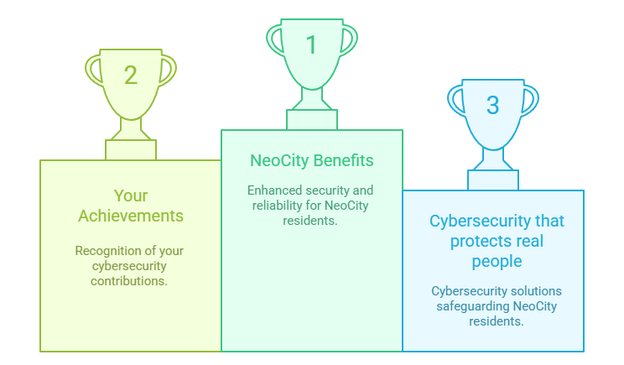
10. What You Learned. NeoCity Outcomes
From cybersecurity analysis to operational decision support
You linked cyber risk to smart-city safety
You validated an operational threat through hands-on testing
You communicated alerts to traffic operators and decision makers
You applied a layered mitigation strategy (Drop Rules + Rate Limiting)
NeoCity is now safer and more resilient under attack conditions
Notes:
This slide brings together what you have achieved throughout Part 3 and why it matters for a real smart-city deployment like NeoCity.
You started by building on the technical findings already discovered: a denial-of-service attack could disrupt the MEC API that helps control connected traffic signals. Instead of stopping at detection, you investigated how to communicate risk and operational impact to the people who need to make decisions.
Then, you evaluated several mitigation strategies, not simply on technical merit, but based on their contribution to public safety, availability, and deployment feasibility. You compared defense options using a structured decision matrix, which allowed you to choose the solution that keeps the smart traffic system functioning even under adverse conditions.
The final result is a layered defense strategy. Suricata Active Drop Rules stop malicious traffic early and quickly. API Rate-Limiting ensures that even if some attack traffic reaches the MEC service, legitimate users get priority. Together, they reduce residual risk and support continuous operation of critical mobility services.
From the NeoCity perspective, this means that smart mobility infrastructure becomes more resilient to cyber attacks. Citizens and vehicles can continue moving safely, and emergency response remains possible during an incident.
From your learning perspective, you have now followed the full operational cybersecurity lifecycle:
detect the issue, monitor the impact, communicate the risk, and support a justified decision to protect a real system.
You have connected cybersecurity analysis to smart-city safety, which is at the core of this PBL experience.

